Slide 1
GeoPose 1.0
GeoPose Chairs and Editor
OGC OAB 28 September 2021

Slide 2
Agenda
Overview
Scope
Standardization Targets
Implementation Activities
Relation to Other Standards
OGC
Other SDO
de facto
Q&A

Slide 3
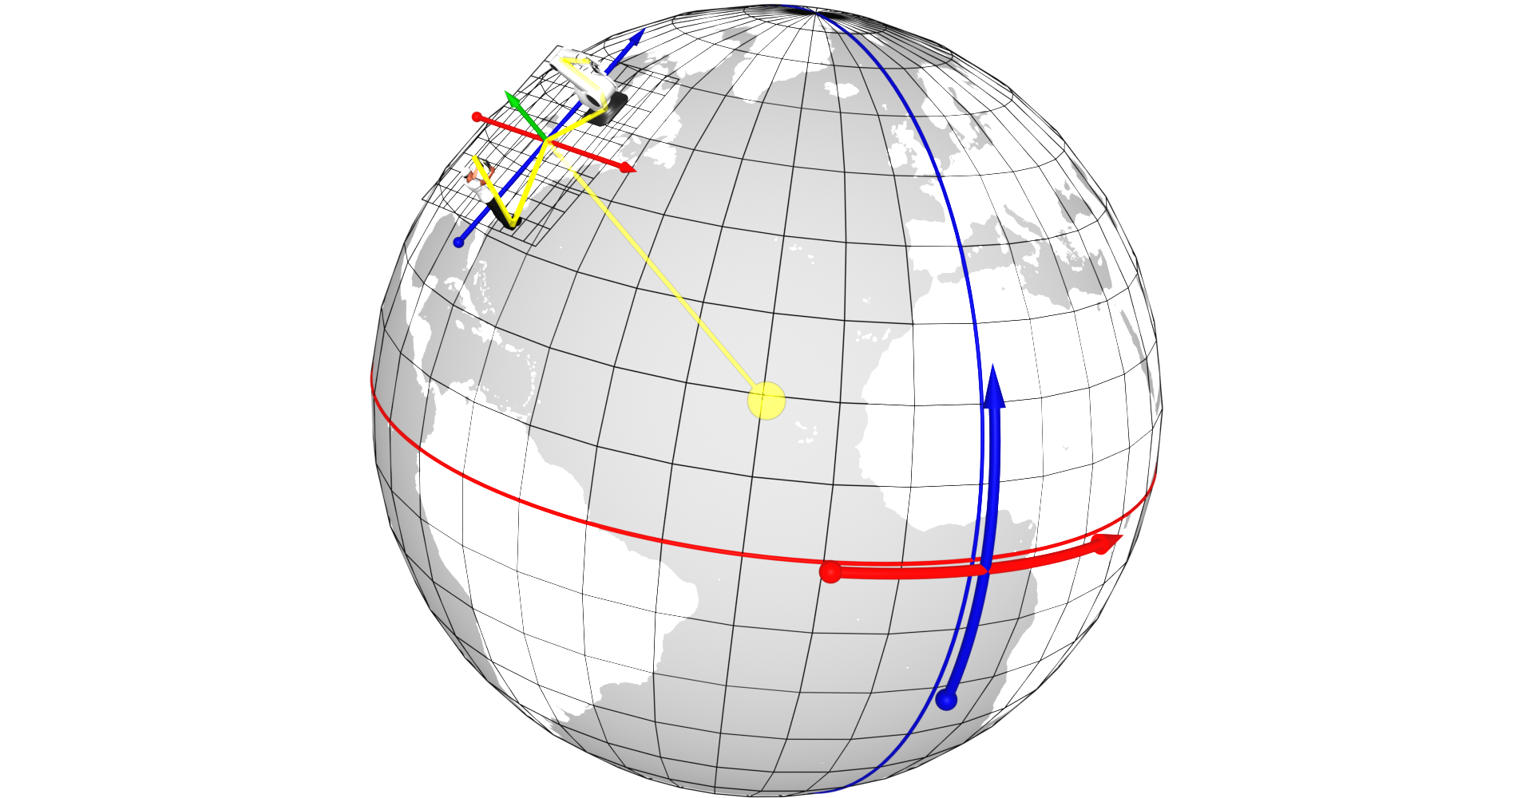
GeoPose
A Pose captures position and orientation of a real or digital object.
A Pose has an associated FrameTransform Chain. The Pose’s FrameTransform Chain encapsulates sufficient information to transform pose geometry in any component Reference Frame to any other Frame in its associated FrameTransform Chain.
A Fixed Pose is a Pose whose associated Outermost Frame is related to an Ephemeris Object - a spatial object whose position and orientation are externally defined.
A GeoPose is a Fixed Pose related to a geospatial Ephemeris Object (the Earth) via a Topocentric Reference Frame.
Short Version:
A GeoPose ties the position and orientation of a spatial object to the Earth’s surface.
Notes:
From this we derive the idea of poses, and the chained reference systems to relate between the geographical, Earth-based system and individual objects and their histories of locations and orientations

Slide 4
Overview: Editorial Team
The GeoPose 1.0 Editorial Team
Chairs
Christine Perey
Jan-Erik Vinje
Jeremy Morley
Editor
Steve Smyth
Visual glossary
Mikel Salazar
Numerous active SWG Members
External experts and guests
Ongoing feedback from Moving Features and CDB

Slide 5
Overview: Document Structure
Use cases to JSON Schema: the process
Normative part:
Specification document with conformance classes directly referencing UML logical model.
UML model as Enterprise Architect 14 project file .
Json object validator uses same JSON-Schema files that are included into the draft’s AsciiDoc files.
Informative part:
Reviewers Guide – Informative explanation of the GeoPose draft standard and its development
Users Guide – Developer-focused implementation guide
Test datasets
Land drone example application (in development ETA 1 November 2021)

Slide 6
Overview: Development Summary
Much of the normative part of the document is created automatically from the UML model. This includes a linked set of JSON-Schema specifications, JSON-encoded example GeoPoses, and an online GeoPose validator for each of the eight standardization targets.
The SWG has actively reached out to OGC and external related standards groups in order to better understand
How GeoPose might be used
Additional use cases
Possible additional requirements
We have received considerable sample data, some of which has been converted to conform to our draft spec. We have a plan to complete an application based on a “land drone” data set from Ordnance Survey GB in October 2021. This application will use every one of the eight independent standardization targets.
The SWG unanimously approved the draft spec with OGC document number 21-056 for OAB review and public comment on 17 September 2021.

Slide 7
GeoPose Scope
Individual concrete data objects for the exchange of anchored poses, each interpretable as a linked position and orientation tied to an externally-defined frame of reference, for example an Earth-centered, Earth-fixed geodetic spatial reference system. The linkage may be direct or through a chain of frame transformations.
Composite structures
Sequences grouping anchored poses in time series and delivered as a packaged sequence or unbounded stream.
Linked structures representing networks of reference frames, expressed as a graph where the nodes are frames and the edges are transformations between the linked frames. Chains are intentionally distinguished as a special type of graph because they are a common special case with a simpler representation.
Out:
API
Transports
Uncertainty: accuracy, precision
Other kinematic or dynamical properties: velocity, acceleration, angular velocity
Camera model

Slide 8
Standardization Targets
The Basic-YPR and Basic-Quaternion targets are simple and concise – no options. They satisfy most use case requirements and assume a local tangent plane east north up (LTP-ENU) frame derived from WGS84 (EPSG 4979).
An Advanced GeoPose target supports more complex use cases where the outer geographic reference frame is not LTP-ENU and/or a valid time is needed.
Composite:
The Chain GeoPose target provides additional flexibility with multiple intermediate frames or specific coordinate reference systems as needed.
The Frame Graph target supports the full structure need to represent networks of reference frames that arise with the use of multiple and linked location technologies.
The three (Time) Sequence targets support the packaging of fixed-length time series of GeoPoses and the payload data objects for open-ended GeoPose streams.
The standardization targets are independent. A minimum conforming implementation need only conform to the requirements of a single encoding of a single target.

Slide 9
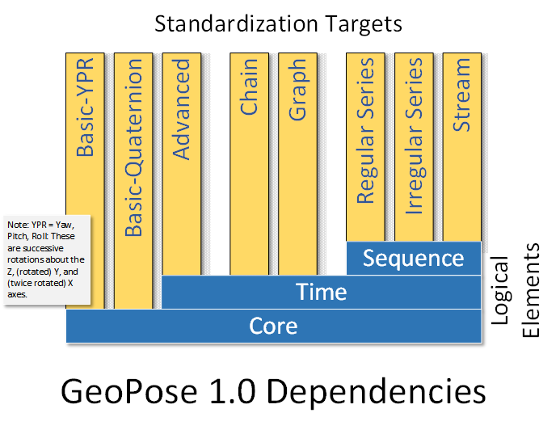
Standardization Target Dependencies

Slide 10
Implementation Activities
Demo web app in GitHub repo
Data samples in GitHub repo.
Conforming examples of each of the eight standardization targets.
Ordnance Survey GB „land drone“ nav sensor and video data (next slide).
Tiled wind field data.
Video and still drone imagery with GeoPose sequences tied to each frame.
A developer‘s sandbox environment.
SolarPose service serves Basic-YPR or Basic-Quaternion GeoPoses for a camera facing the sun for any time or place on Earth.

Slide 11
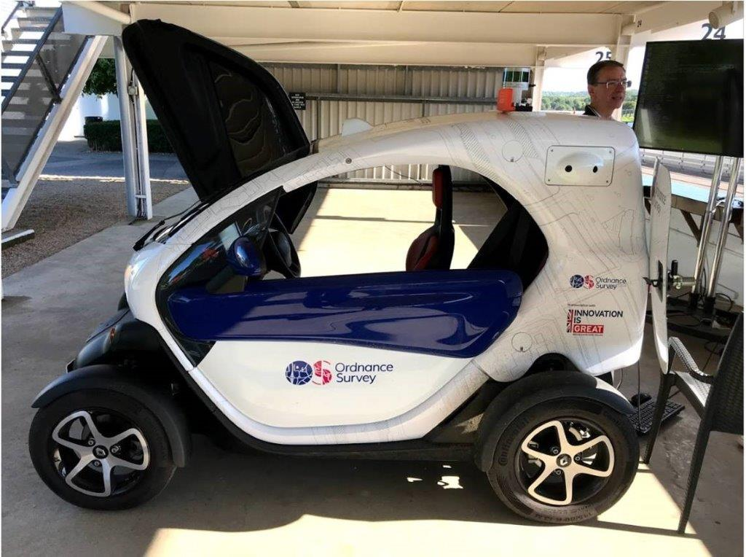
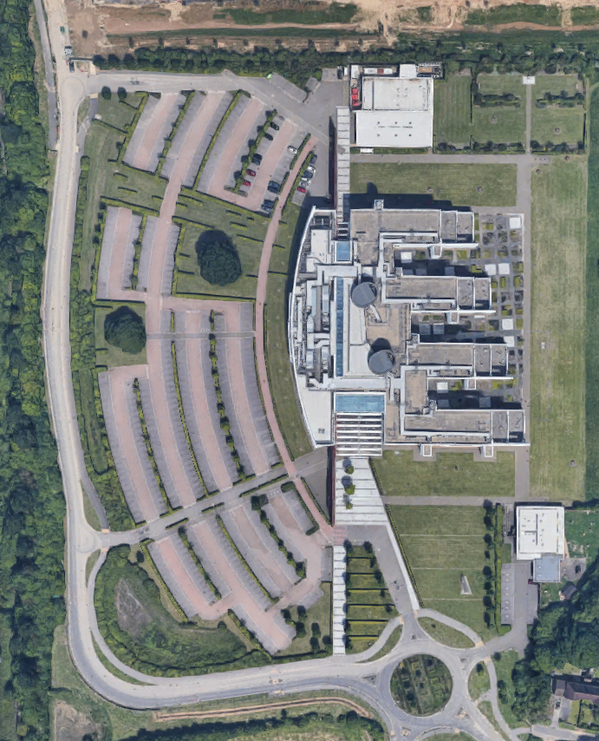

OS GB Autonomous Vehicle Data Experiments
Ordnance Survey (OS) GB has provided navigation sensor and video data on a round-trip track of approximately 1 km (yellow strip).
Seven real-world examples of the use of and computation with each of the eight GeoPose 1.0 Standardization Targets:
Basic-YPR, Basic-Quaternion, Advanced:
Goal 1: Serve one Basic GeoPose of selected type for either nav sensors or video at any time within the data time span
Chain
Goal 2: Serve GeoPose chains using the nav sensor frame as a link at any time within the video data time span
Graph
Goal: 3 Serve GeoPose graphs with multiple target GeoPoses at any time within the video data time span
Series
Goal 4: Serve nav sensor or video poses at a specified rate as a regular series
Goal 5: Serve nav sensor or video poses as an irregular series
Stream
Goal 6: Serve nav sensor or video poses from start to end at real time rate
Goal 7: Demo web app using Google Street View to animate stream

Slide 12
Relationship to Other Standards
OGC
Ongoing linkage with CDB, CityGML, Moving Features
Probable connections to IoT, O&M, SWE, 3D Tiles
External
Early inspiration came from NASA SPICE
Questionnaire sent to a wide range of possible implementers
Ongoing linkage with Khronos, OARC, modelling and simulation, and AR content creation communities
Reaching out to and compiling intersections with W3C, ISO, IEEE, MISB, ASTM, ASPRS, and BuildingSmart

Slide 13
Q&A
OAB

Slide 14
GeoPose SWG
geopose.swg@lists.opengeospatial.org
Contact info@ogc.org to schedule a meeting for an in-depth discussion with OGC staff and join our community today!
Notes:
If you have any questions, do not hesitate to reach out to OGC or schedule a follow-up. We’re working constantly to change the landscape of location information and want to help your organization get where it needs to go.

